Slide 1
Lec - 9

Slide 2

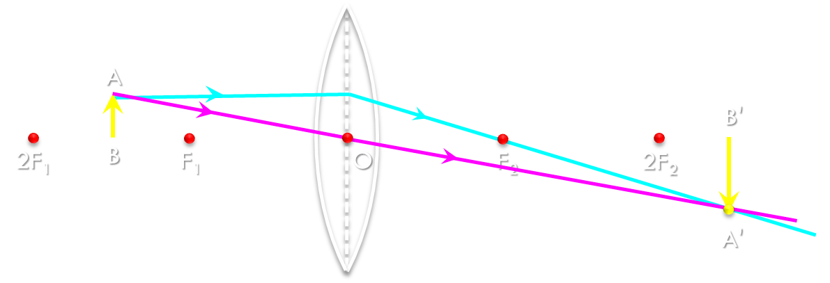
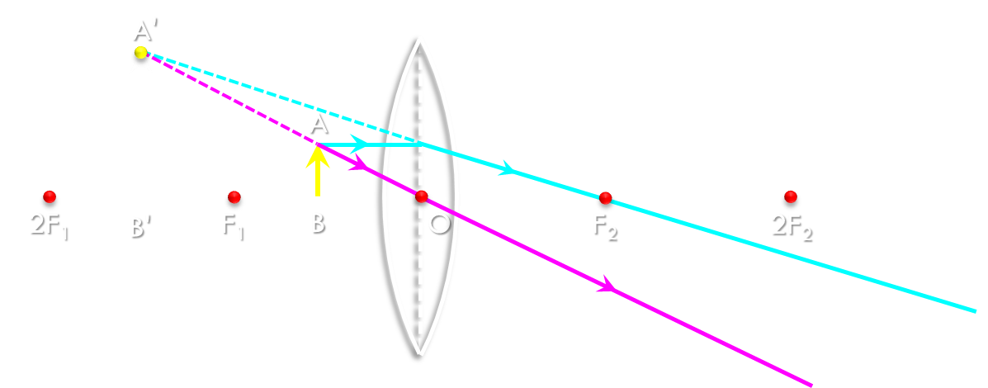
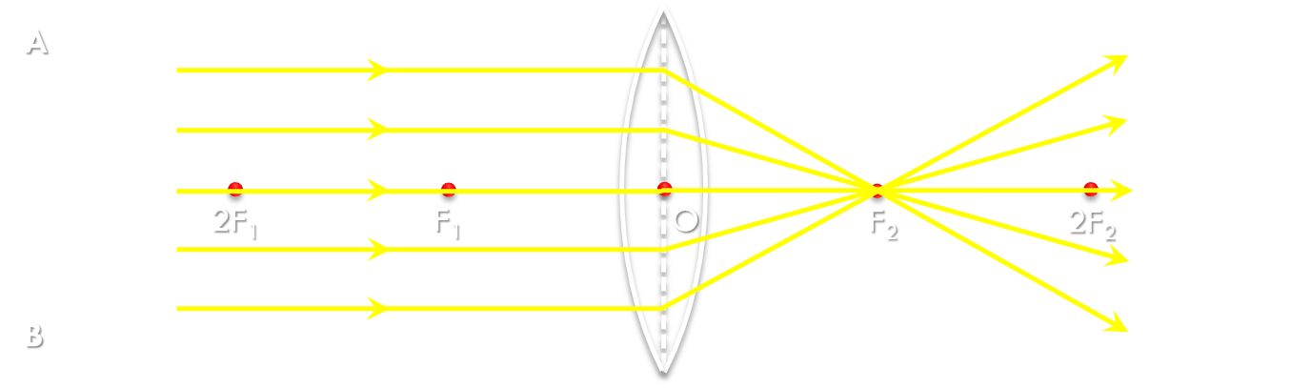
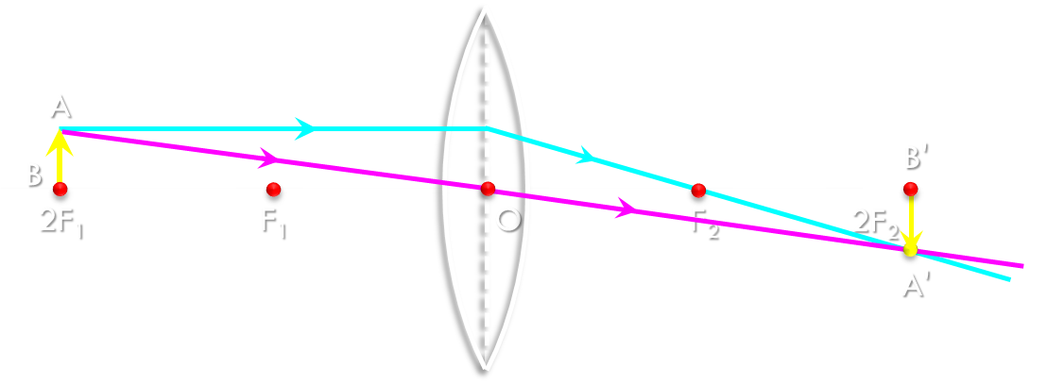
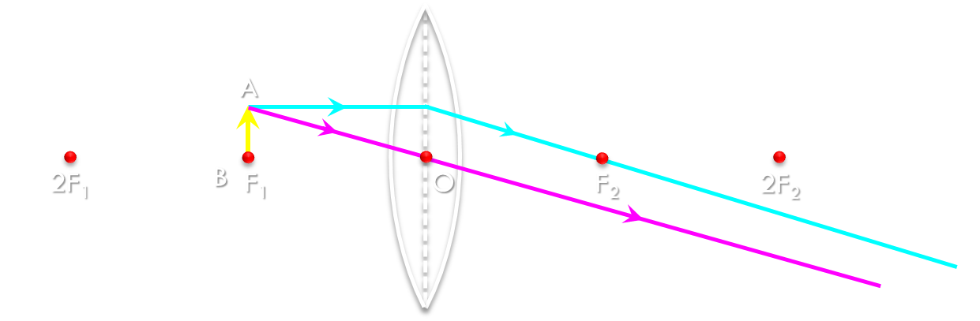
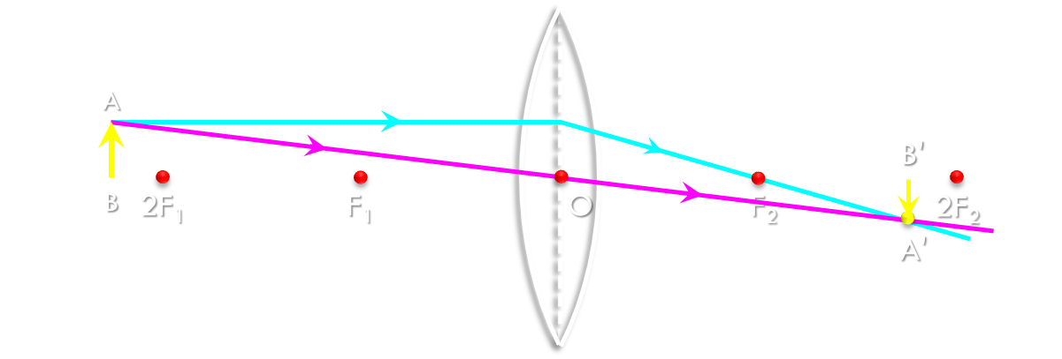
Position of object
Position of image
Size of image
Nature of image
At infinity
At focus F₂
Point image
Real & inverted
REVISE ALL LENS RAY DIAGRAMS IN 3 MINUTES
At focus F₁
At infinity
Very large
Real & inverted
Between F₁ & 2F₁
Beyond 2F₂
Larger
Real & inverted
Beyond 2F₁
Between F₂ & 2F₂
Smaller
Real & inverted
At 2F₁
At 2F₂
Same size
Real & inverted
Between F₁ and O
On the same side of the lens as the object
Very large
Virtual & erect

Slide 3
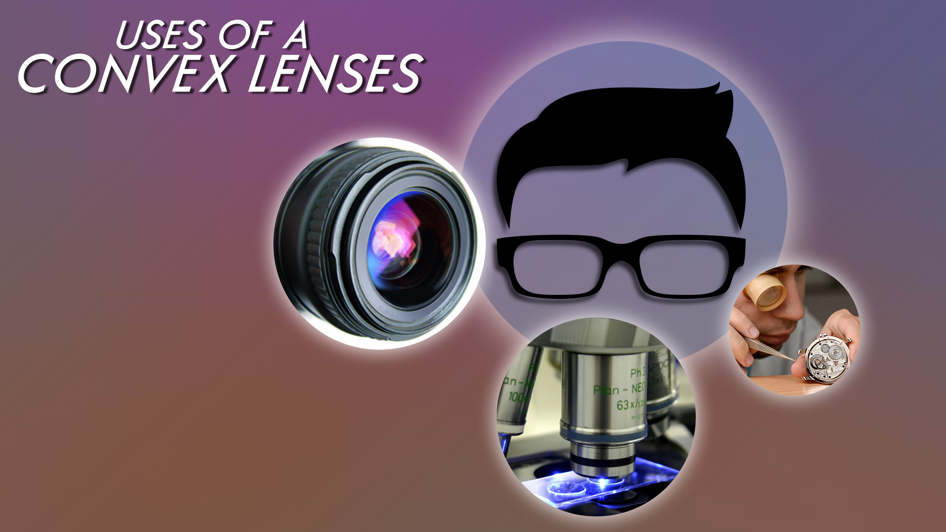
1. Making microscope, telescope and slide projectors.
2. Making a simple camera.
3. As a magnifying lens by watchmakers.
4. Used in spectacles to correct the defect
of vision called hypermetropia.

Slide 4
RAY DIAGRAM
RULES FOR MAKING RAY DIAGRAMS
RULE
1
A ray of light which is parallel to the principal axis of a concave lens, appears to be coming from its focus after refraction through the lens.
2F₁
F₁
O
F₂
2F₂

Slide 5
RAY DIAGRAM
RULES FOR MAKING RAY DIAGRAMS
RULE
2
A ray of light passing through the optical centre passes through the optical centre undeviated.
2F₁
F₁
O
F₂
2F₂

Slide 6
RAY DIAGRAM
RULES FOR MAKING RAY DIAGRAMS
RULE
3
A ray of light going towards the focus of a concave lens, becomes parallel to its principal axis after refraction through the lens.
2F₁
F₁
O
F₂
2F₂

Slide 7
Object at infinity
A
If the incident ray is parallel to the principal axis
The refracted ray appears to be coming from its focus F₁
2F₁
F₁
O
F₂
2F₂
B
Position of Image :
At focus
Nature of Image :
Virtual
Erect
(C) Point image

Slide 8
Object between 2F₁ and F₁
P
P'
The refracted ray appears to be coming from its focus F₁
2F₁
Q
F₁
Q'
O
F₂
2F₂
If the incident ray is parallel to the principal axis
After refraction passes undeviated through the lens
Position of Image :
At focus
Nature of Image :
Virtual
Erect
(C) Smaller

Slide 9


USES OF A
CONCAVE LENSES
1. Used as eye-lens in Galilean telescope.
2. Used in combination with convex lenses to make high quality lens systems for optical instruments.
3. Used in wide angle spyhole in doors.
4. Used in spectacles to correct the defect of vision called myopia

Slide 10
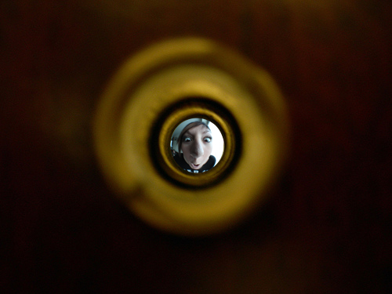
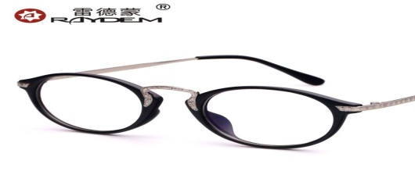
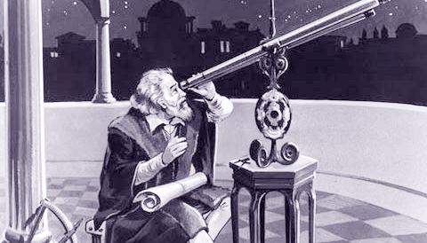
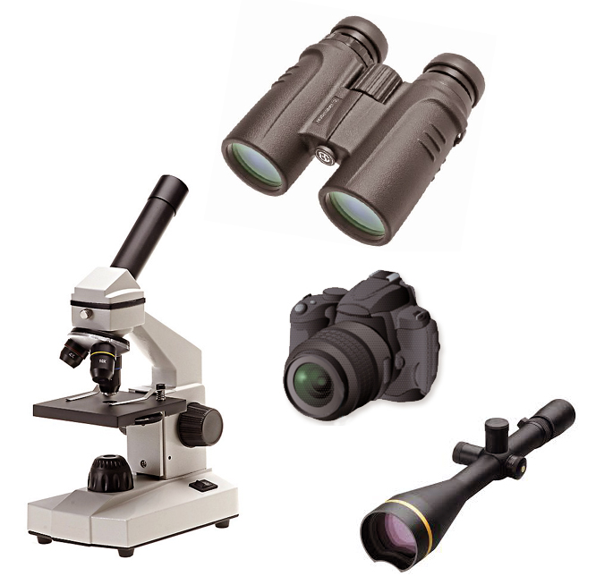
Uses of a concave Lenses
1
Concave lens is used as eye-lens in Galilean telescope
Concave lenses are used in combination with convex lenses to make high quality lens systems for optical instruments.
2
3
Concave lens is used in wide angle spyhole in doors.
Concave lenses are used in spectacles to correct the defect of vision called myopia
4

Slide 11

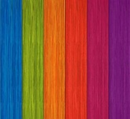
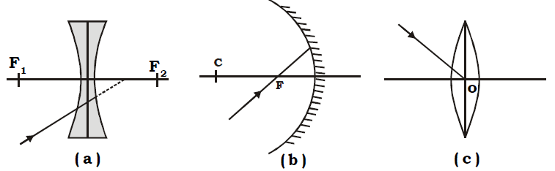
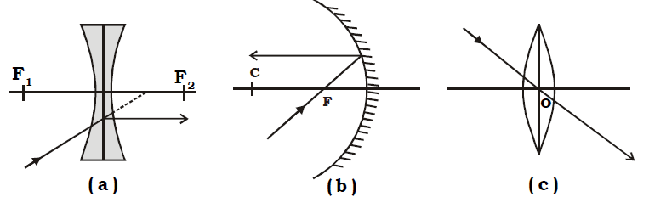
Q.
Draw the pathway of light after its incidence on the lens/mirror
in the following figures :
Ans.

Slide 12
What type of lens must be placed at XY so that image I shifts to I’
Q.
X
I
I’
Sol :
Concave lens
Y

Slide 13
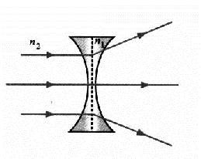
A concave lens made of a material of refractive index n₁ is kept in a medium of refractive index n₂. A parallel beam of light is incident on the lens.
Complete the path of rays of light emerging from the concave lens if (i) n₁ > n₂
Q.
Ans.
When n₁ > n₂. light goes from rarer to denser medium, Therefore, in passing
through a concave lens, it diverges.

Slide 14
Q.
Study the given ray diagrams and name the devices X and Y and their focal lengths respectively.
Screen
Screen
20 cm
20 cm
Ans.
Device X is a convex lens of focal length 20 cm.
Device Y is a concave mirror of focal length 20 cm.

Slide 15
Which of the following lenses would you prefer to use while reading small letters found in a dictionary?
(a) A convex lens of focal length 50 cm.
(b) A concave lens of focal length 50 cm.
(c) A convex lens of focal length 5 cm.
(d) A concave lens of focal length 5 cm.
Q.
Ans.
(c) A convex lens of focal length 5 cm.

Slide 16
EXTRA QUESTION

Slide 17
(ii) You have three lenses L₁, L₂ and L₃ of powers +10D, +5D and -10D respectively. State the nature and focal length of each lens.
(iii) Explain which of the three lenses will form a virtual and magnified image of an object placed at 15 cm from the lens.
Q.
Ans.
100
100
(ii) Lens L₁ : f₁ =
=
= +10 cm ; Convex lens
P₁
+10
100
100
Lens L₂ : f₂ =
=
= +20 cm ; Convex lens
P₂
+5
100
100
Lens L₃ : f₃ =
=
= -10 cm ; Concave lens
P₃
-10
(iii) Lens L₂ will form a virtual and magnified image of an object placed at 15 cm from the convex lens because concave lens can never form virtual and magnified image of an object and convex lens form such image only when the object is placed between the optical centre and principle focus of the convex lens.

Slide 18
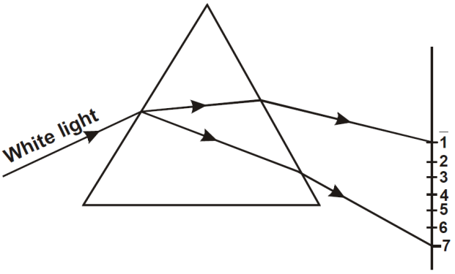
A beam of white light falling on a glass prism gets split up into seven
colours marked 1 to 7 as shown in the diagram. A student makes
the following statements about the spectrum observed on the screen.
Q.
(a) The colours at position marked 3 and 5 are similar to the colour of the core of a hard–boiled egg colour and the colour of the sky respectively.
Is the statement made by the student correct or incorrect? justify.
b) Which of the two positions correspond closely to the colour of
(i) a solution of potassium permanganate,
(ii) Danger or stop signal light ?
c) State and define the phenomenon observed.
Ans.
(a) 3 and 5 are yellow and blue respectively. The student has identified them as yellow (colour of the core of a hard – boiled egg) and blue (i.e., colour of sky) respectively. Hence, the statement is correct.
(b) (i) Position 7 is the position of violet colour.
(ii) Position 1 is the position of red colour.
(c) (i) The phenomenon observed here is dispersion of light.
(ii) The splitting of while light into its constituent colours,when passed through a prism, is called dispersion of light.

Slide 19
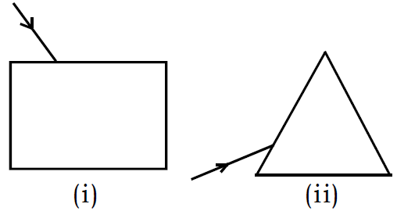
(a) A very thin narrow beam of white light is made incident on two glass objects shown below. Comment on the nature and behavior of the emergent light in all the cases.
Q.
Ans.
(a) In (i) emergent beam is white, laterally displaced.
In (ii) emergent beam is a spectrum of seven colours bent by different angles.

Slide 20
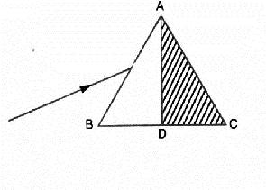
A ray of light is incident on a prism in the minimum deviation position as
shown and it suffers a deviation of 40º.
What will be the deviation suffered if the shaded half of the prism is removed?
Q.
Ans.
A ray of light which suffers minimum deviation always passes parallel to the base. It thus is incident on the face normally and suffers no further deviation.
Thus, the deviation is halved i.e. 20º.

Slide 21
A glass slab is placed over a page on which the word VIBGYOR is
printed with each letter in its corresponding colour.
(i) Will the image of all the letters be in the same plane?
(ii) If not, state which letter will be raised to the maximum.
Q.
Ans.
(i) No, the images of letters of different colours will be raised by
slightly different heights.
(ii) The letter, V, corresponding to the violet colour will be raised to
the maximum. This is because, Apparent depth = real depth / n
Now, n is maximum for the violet colour. Its apparent depth would,
therefore, be the least.
Hence, the violet colour (letter V) would be raised to the maximum.

Slide 22
The image of a candle flame formed by a lens is obtained on a screen placed on the other side of the lens. If the image is three times the size of the flame and the distance between lens and image is 80 cm, at what distance should the candle be placed from the lens?
What is the nature of the image at a distance of 80 cm and what is
the type of lens?
Q.
Ans.
Given, m = – 3, v = 80, cm, u = ?
Using the expression
m = v/u, we have –3 = 80/u
or u = –80/3 = 26.67 cm
The image is real and the lens is a convex lens.

Slide 23
Thank You

